Slide 1
Project Management

Slide 2
Team Member
Mohamed Mustafa Abd Eltwab
Mohamed Mahmoud Ahmed

Slide 3
Project name: Saving electricity
Project sponsor: Ministry of electricity and energy .
Project manager: Eng/ Alaa Abd Elfatah
Purpose of the project: helping citizens to conserve electricity.
Business case: the application in used to bring money by saving electricity and control electricity-power and function through Egypt.

Slide 4
Project deliverables:
Project plan, reports, documents and resources which return to the company.
Saving money, electricity and time.
App that can work on both ios and android.

Slide 5
Project milestones :
In the first two weeks , the team of electrical engineers will collect information on remote control and consumption of electrical devices .
For month , engineers will make remote receivers.
For Two weeks , a team of programmers will make the mobile application .
The project is being tested for a week .
Project resources:
A team of electrical engineering.
A team of programing.
Device of receiver

Slide 6
Budget:
1000,000 $ (includes servers, project licenses, developers, designers, training)
Constraints:
The project must take time less than 4 months.
The project must not exceed 1000,000 $.
laptops and computers must be bought from dell company.

Slide 7
High level risks:
Damage in the receivers.
Increase in the cost.
The lack of efficiency sufficient in the receiver or the teams.
Not to satisfy the users of product.

Slide 8
Project Scope
Project scope description :
Project acceptance criteria:
Project deliverables:
Project exclusion :
Project constraints:
Project assumptions:

Slide 9
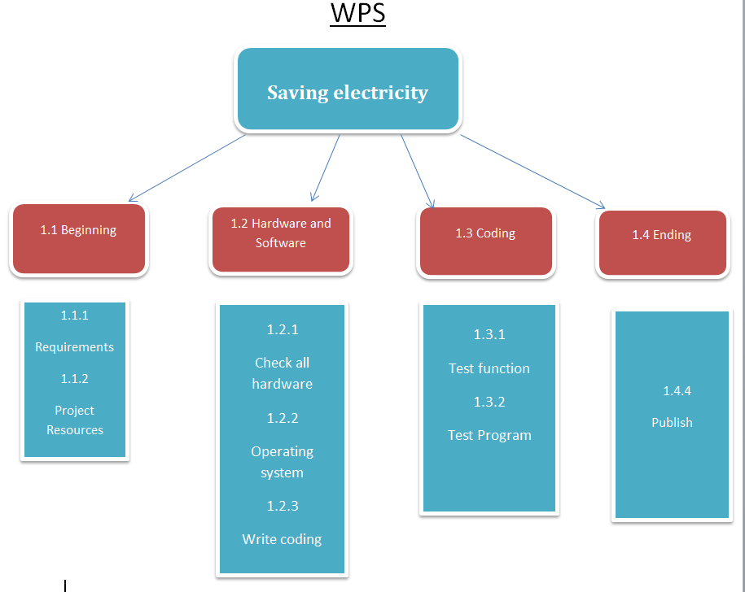

Slide 10
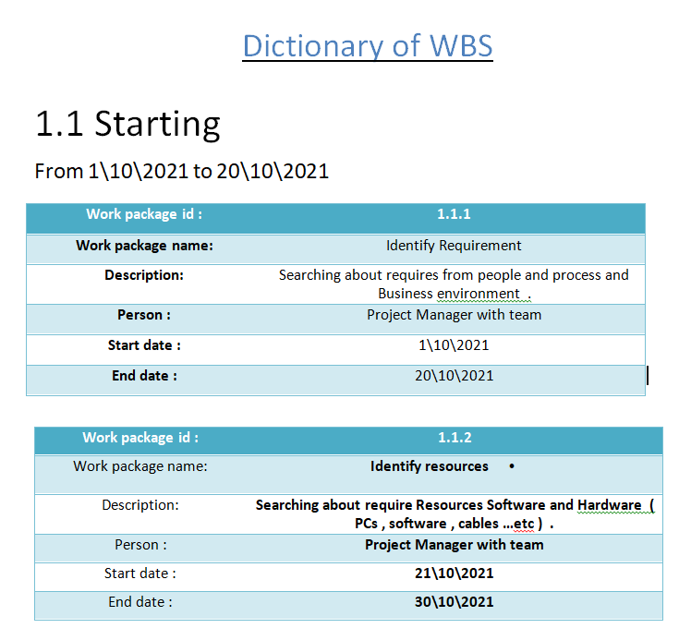
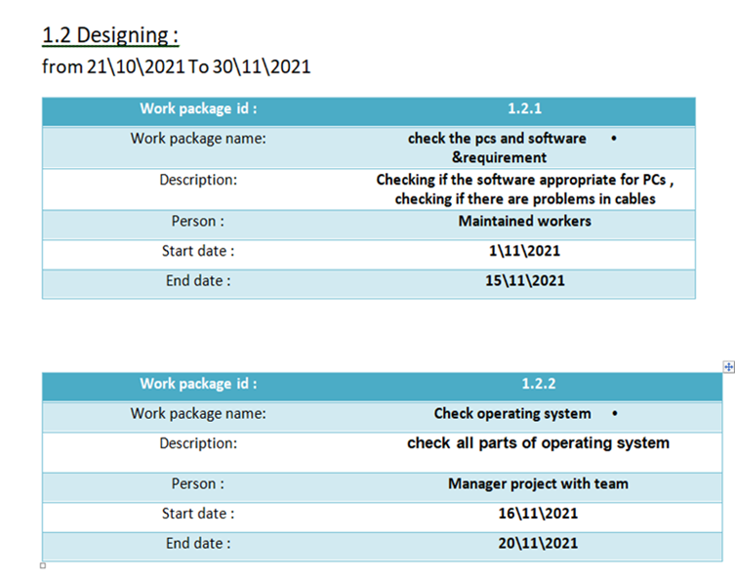
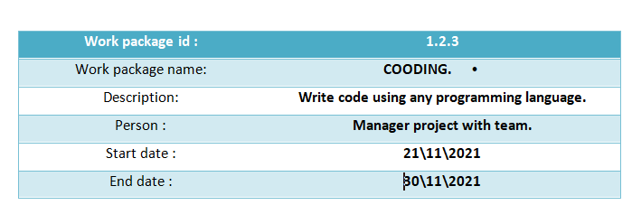

Slide 11
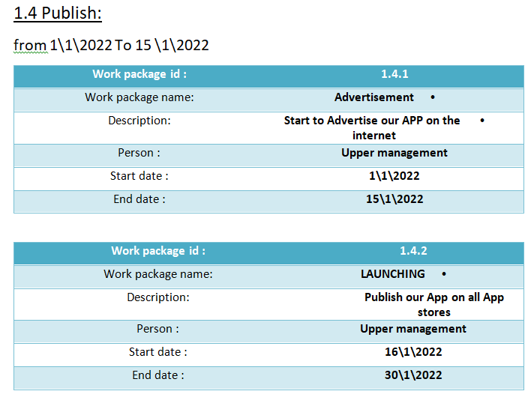
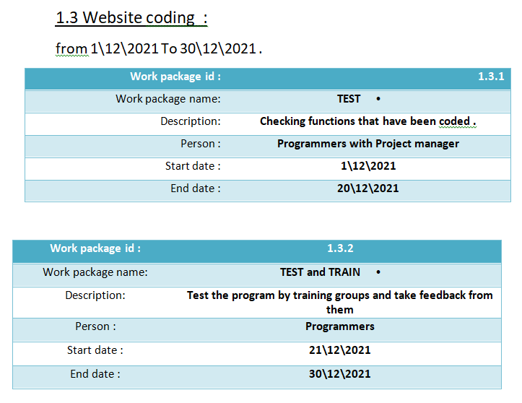

Slide 12
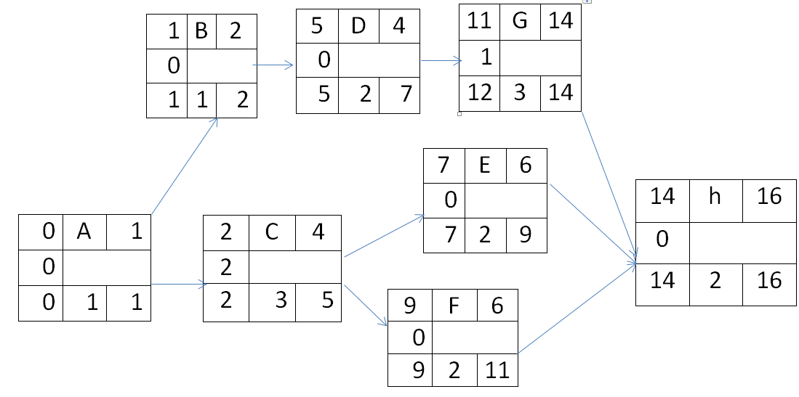

Slide 13
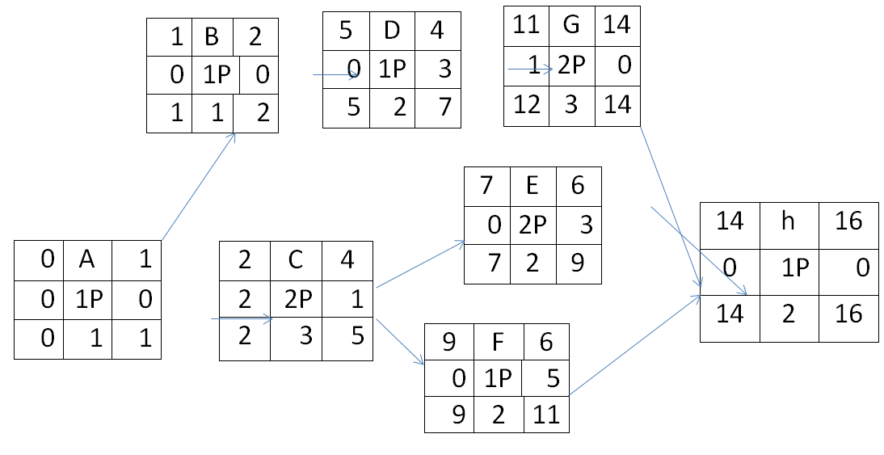
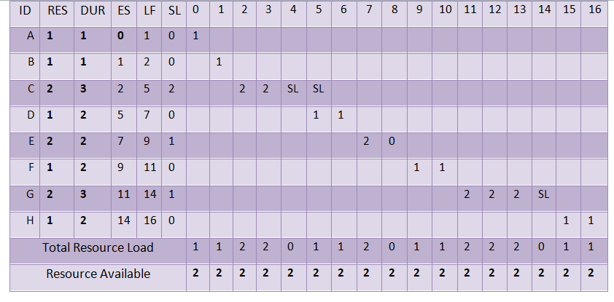

Slide 14
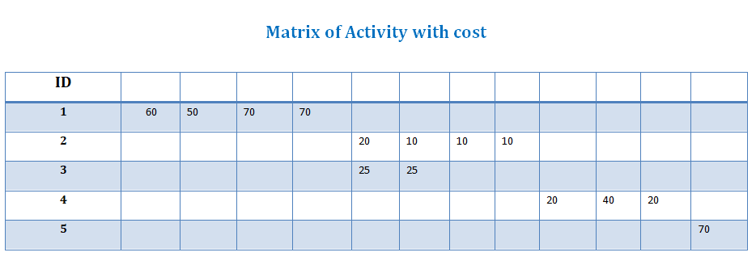
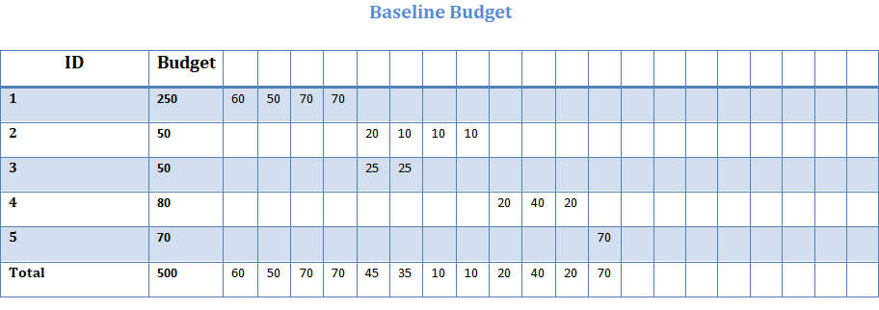

Slide 15
Risks
Negative risks:-
Interruption of the Internet.
hackers.
One of our employee leave the company.
Another competitive company make the same technology with better quality than us.
Damage in the receivers.
Increase in the cost.
The lack of efficiency sufficient in the receiver or the teams.
Not to satisfy the users of product.

Slide 16
Risks
Positive risks:-
There is only our company in the market.
Make a change in company that may improve our technology.
This application work The IOS and Android and windows operating system

